Slide 1
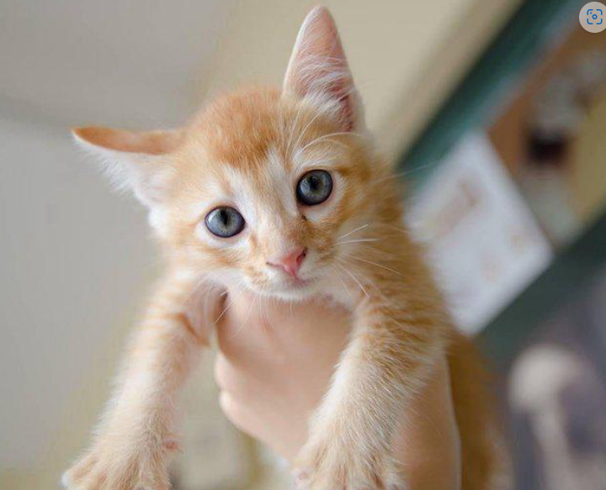
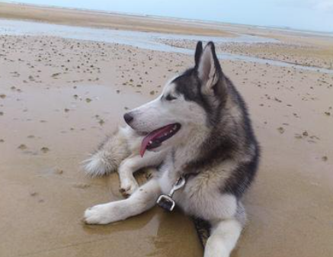
Improving Animal Adoption Through Machine Learning
Capstone Project By
Oswaldo Olivo, Pradeep Chelpati, Krishnaprasad Kongoorppalli

Slide 2
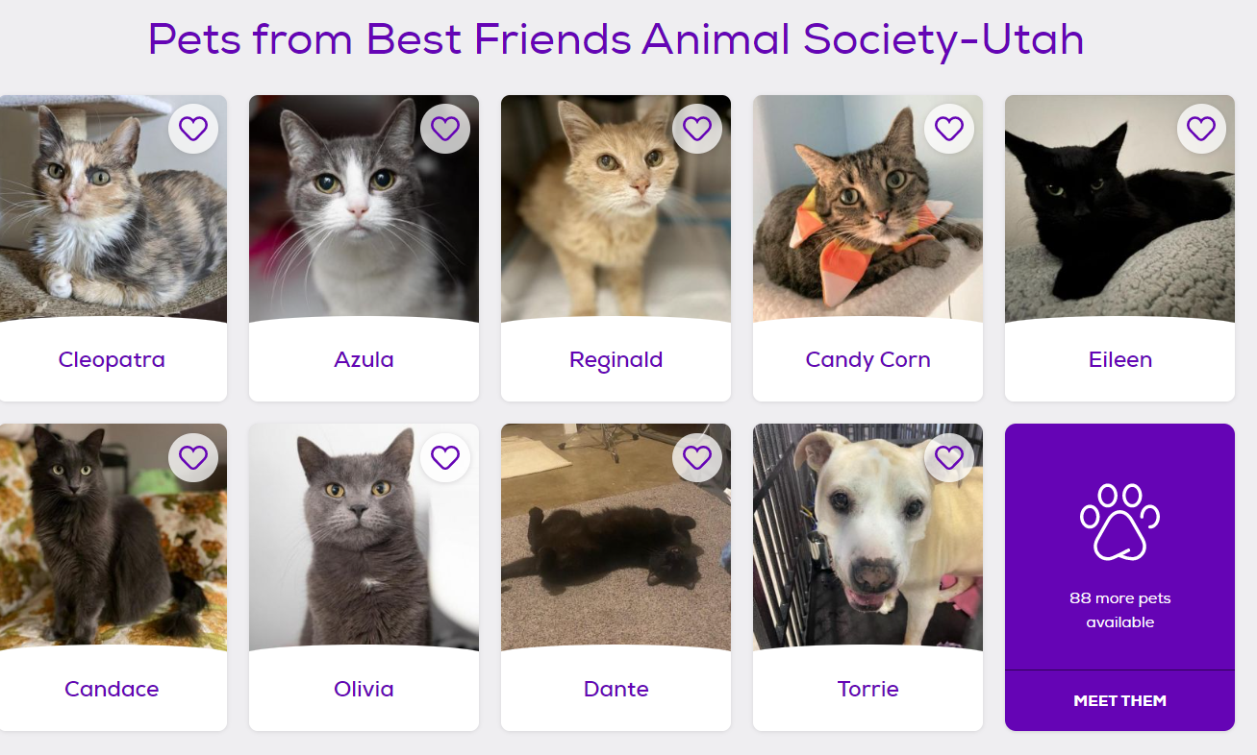
Problem
Every year, more than one million adoptable animals get euthanized due to lack of space or funding.
Shelters use social media sites such as Facebook or Instagram, and dedicated adoption websites such as PetFinder to post pet profiles to facilitate adoption.
But it’s difficult to figure out how to write a profile that gets animals adopted successfully.

Slide 3
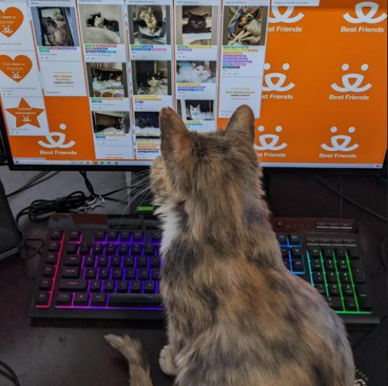
Approach
Our goal to use a data-driven approach to predict pet adoption speeds, as well as provide suggestions for improving the pet profiles.

Slide 4
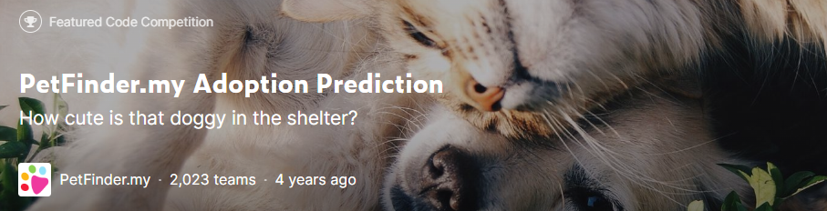
Data
The PetFinder Kaggle competition provides a dataset for predicting adoption speeds for cat and dog profiles in Malaysia during 2019.
Categorical features from the dataset: Type, Breed, Color, Size, Fur, Health status, State, Adoption speed (1day, 1 week, 1 month, 3 months, not adopted).
Numerical features from the dataset: Age, Quantity, Fee.
Additional computed features: Sentiment analysis (probabilities and magnitude), image quality (blurriness, animal ratio and confidence of animal identification).

Slide 5
Promising Statistical Results
Sentiment analysis:
Hypothesis: Is there a statistically significant difference in the means of negative sentiment probabilities of adopted versus non-adopted pets?
Answer: Yes, with a p-value of 0.0045.
Insight: Adopted pets have descriptions with less negative sentiment.
Image analysis:
Hypothesis: Is there a statistically significant difference in the average blurriness of adopted versus non-adopted pets?
Answer: Yes, with a p-value of 2.29 * 10^(-25)
Insight: Adopted pets have less average blurriness in their pictures.

Slide 6
Sentiment Analysis
This handsome yet cute boy is up for adoption. He is the most playful pal we've seen in our puppies. He loves to nibble on shoelaces , Chase you at such a young age. Imagine what a cute brat he will be when he grows. We are looking for a loving home for Hunter , one that will take care of him and give him the love that he needs.
ve... she can obey wht command that u told her.. example shakeshand . sleep and eat .. command in english n tamil :).. she will bark if thr suspicius ppl... good for guard act like a male dog..she will sleept in mattres or cradle..whn she eat u can even touch her...we let her because no time to care she... so anyybody intrested to addopt plss call to.. im Mr.Tom..thx petfinder..
He was abandon by the owner to die.
Have no experience with puppies/dogs

Slide 7
Sentiment Analysis
Potential Feedback:
Point to negative sentences, and rewrite them.
Remove excessively negative sentences.

Slide 8
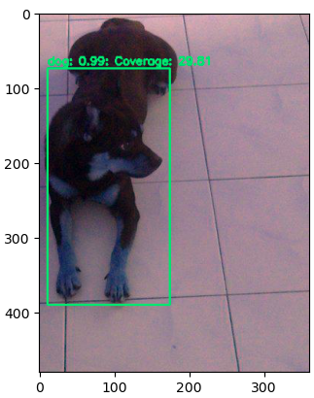
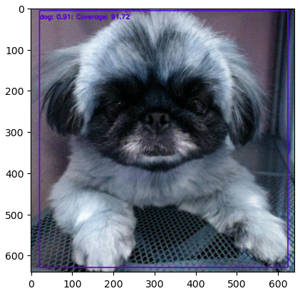
Image analysis
Image coverage: Ratio of pet face over total image size
Yolo v3 pretrained model was used to map the bounding boxes and get confidence on object classification.
Bounding Box width and heights were used to get coverage
Only profile image was considered for coverage analysis

Slide 9
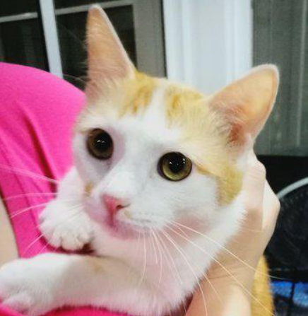
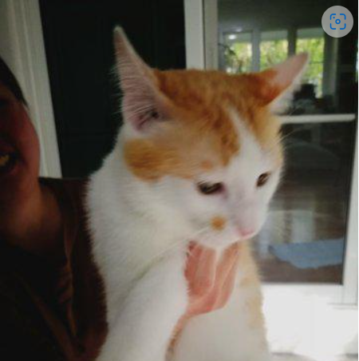
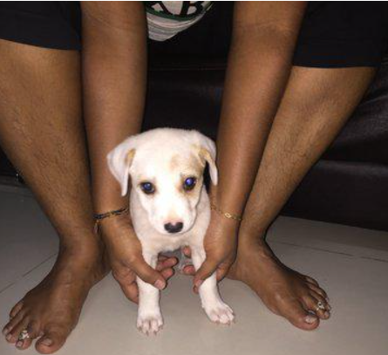
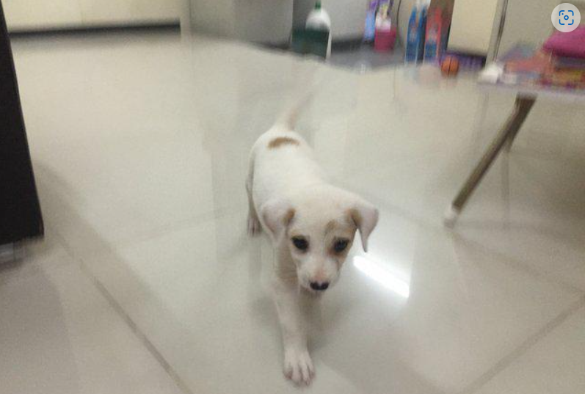
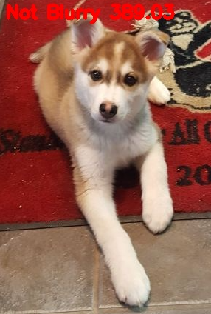
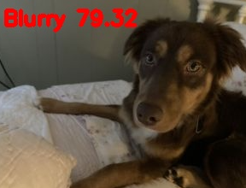
Image Quality
Blurriness is factored in as an image attribute
Laplacian Variance was used to understand blurriness impact
There was variation on the attribute based on the quality of images on different profile
Laplacian Variance of 245.57 vs 78.53
Laplacian Variance of 1299.29 vs 301.19

Slide 10
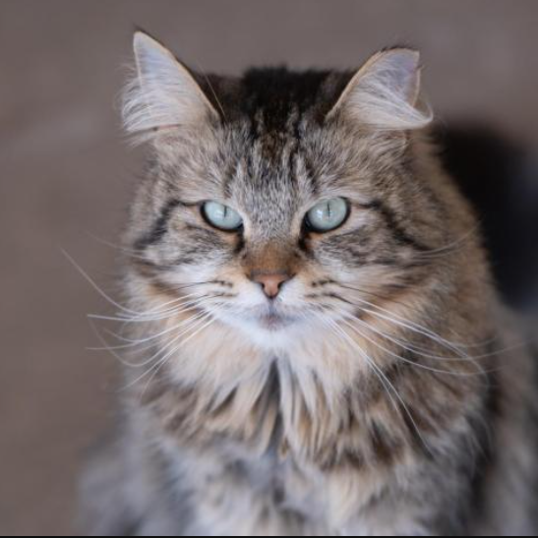
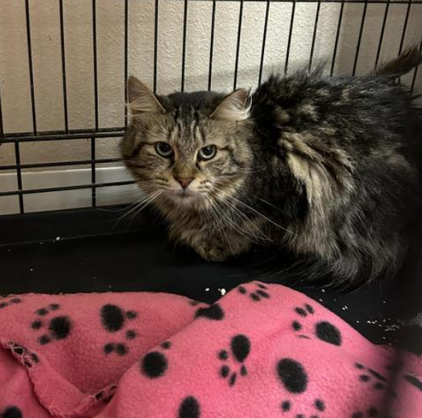
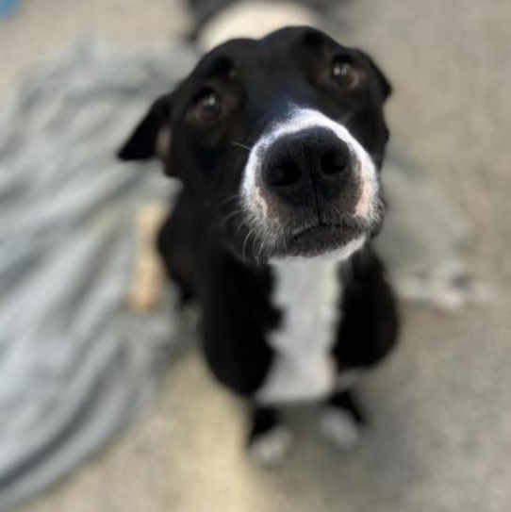
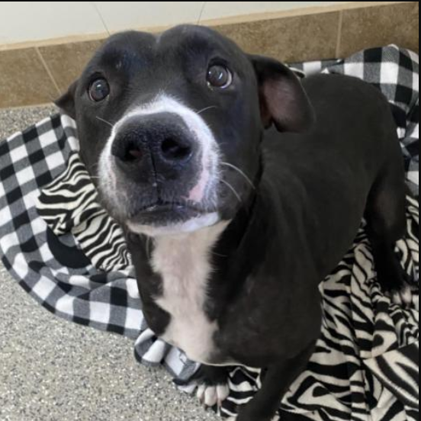
Image Quality
Potential feedback:
Retake a picture.
Remove the blurriest picture.
Replace the profile picture with a better picture from the set.

Slide 11





Integration Architecture
UI Layer
Petfinder API
Front end
HTTP (Restful call)
HTTP API Service
HTTP (Restful call)
Blurriness Svc
Model.pkl
Back end
URL: http://animaladoptionucberkeley.s3-website.us-east-1.amazonaws.com/
Sample Data:
id: 59069831
id: 57441810

Slide 12
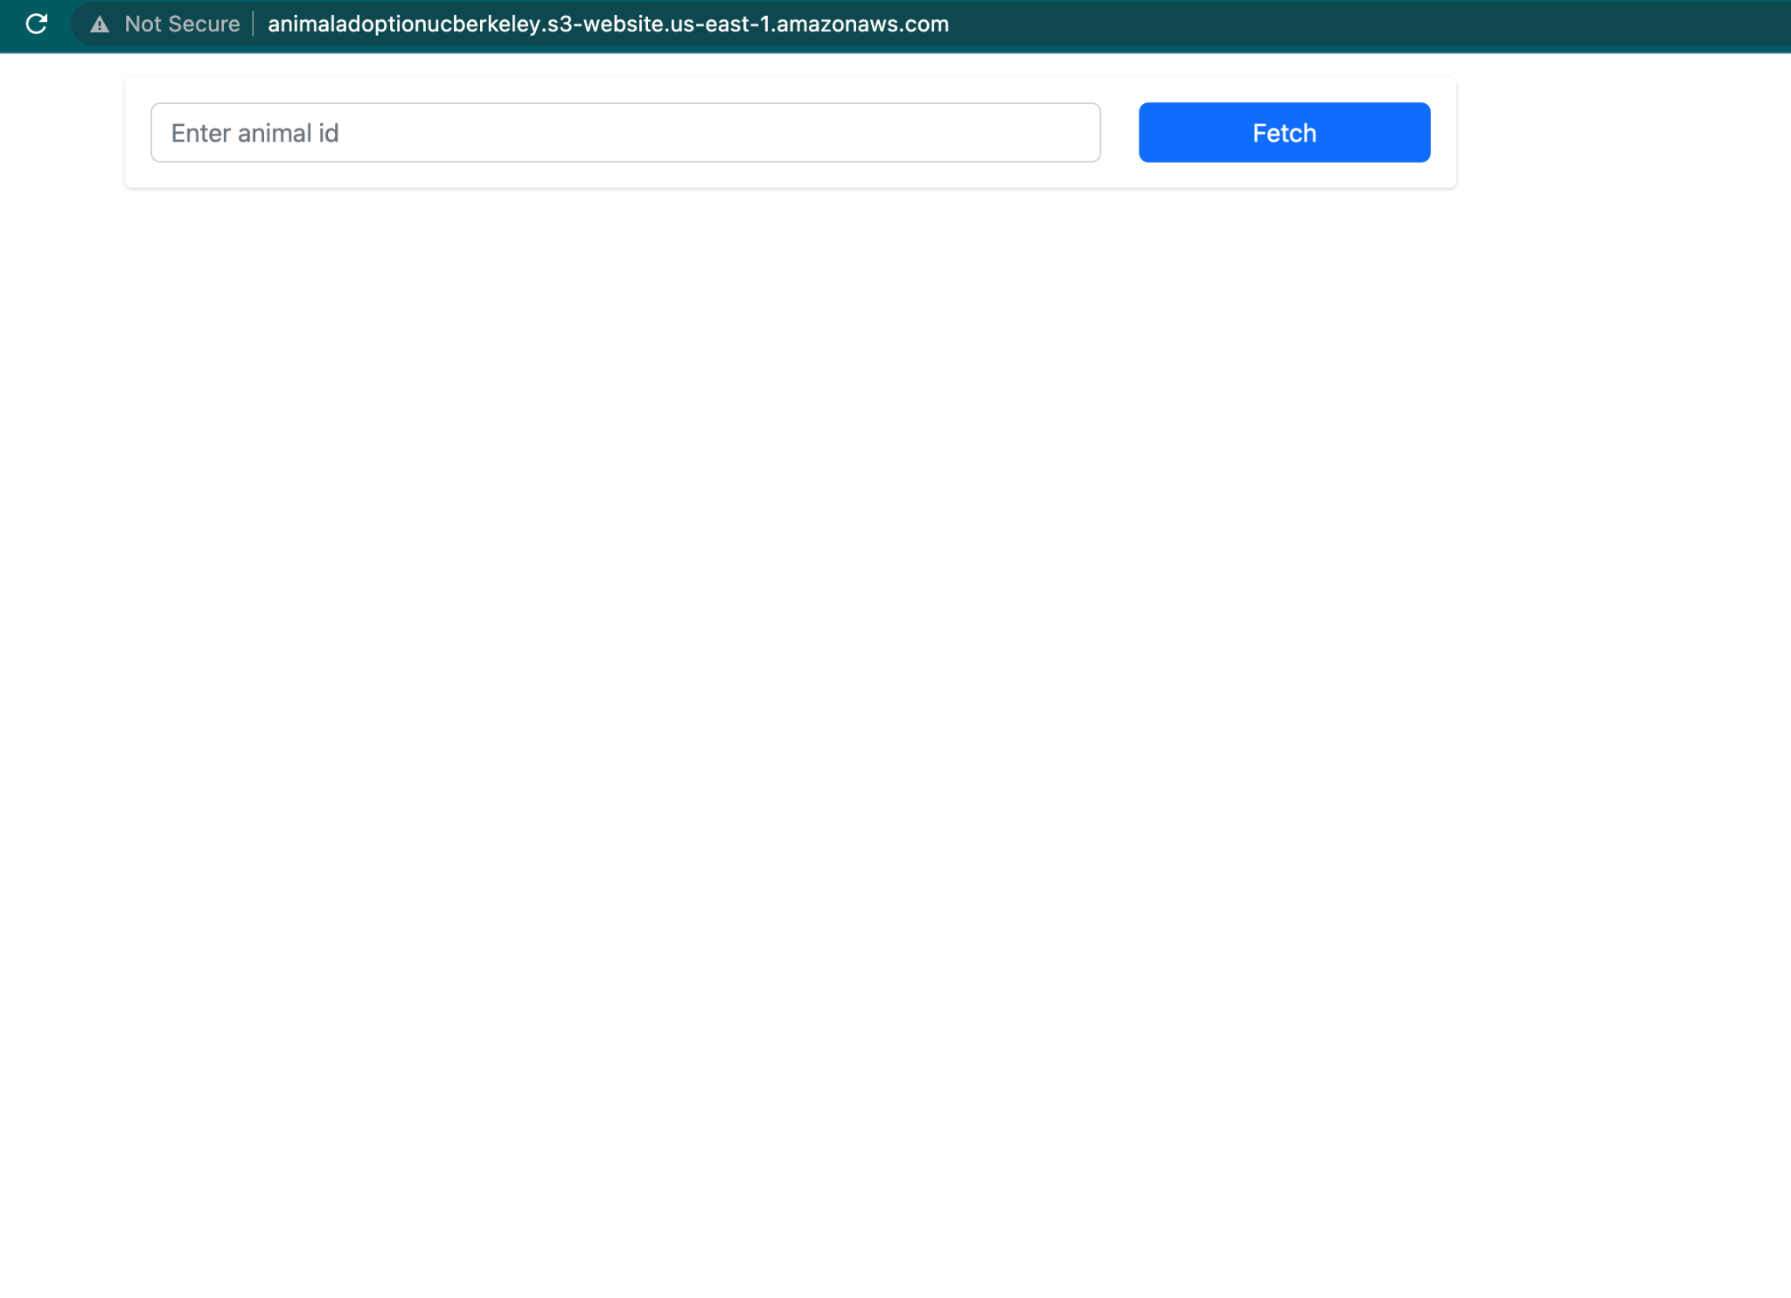
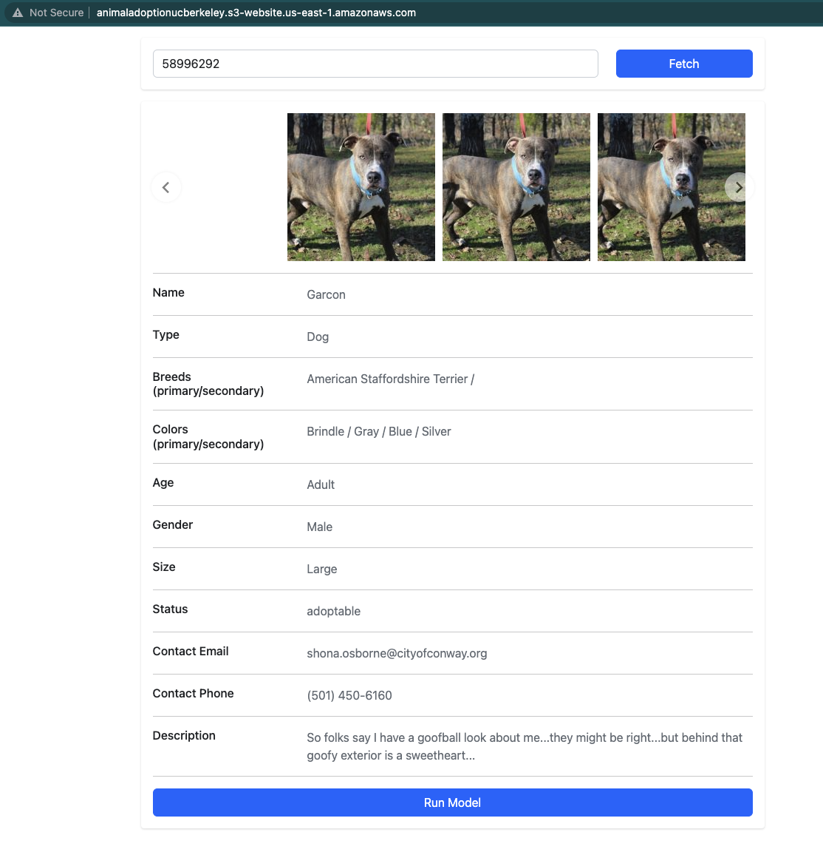
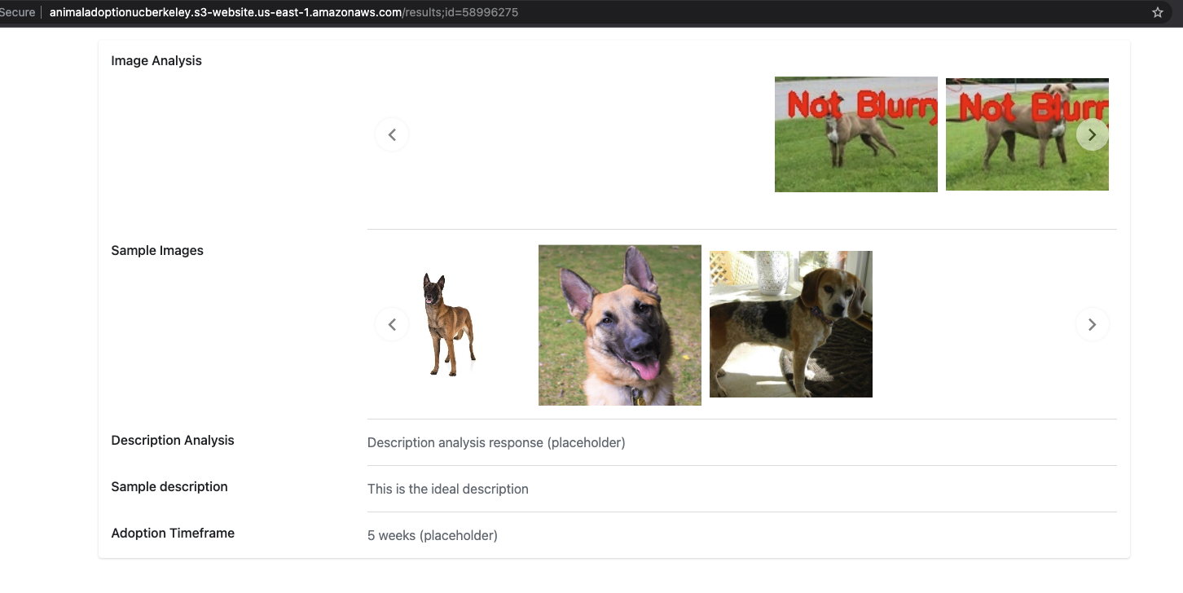
UI Flow
1
2
3
User enter the “Animal Id” into the search box
UI Screen displays the details and an ability for user to run the model and get the recommendations.
Final screen provides image analysis and Adoption Timeframe

Slide 13
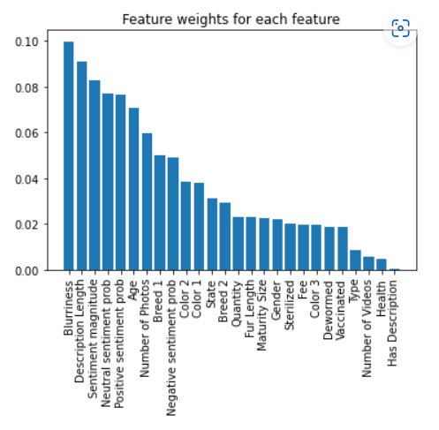
Results
Model | All Features (F1, Acc, Recall)
Decision Tree | (0.28, 0.32 0.28)
SVM | (0.08, 0.28, 0.2)
Bernoulli NB | (0.15, 0.29, 0.21)
Gaussian NB | (0.26, 0.31, 0.26)
MLP | (0.11, 0.29, 0.2)
KNN(N=6) | (0.24, 0.28, 0.24)
Bag + Extra Tree | (0.30, 0.36, 0.30)
Random Forest | (0.33, 0.42, 0.34)
Gradient B DT | (0.31, 0.38, 0.31)
Ada Boost | (0.29, 0.39, 0.30)
Bag + DT | (0.32, 0.37, 0.31)

Slide 14
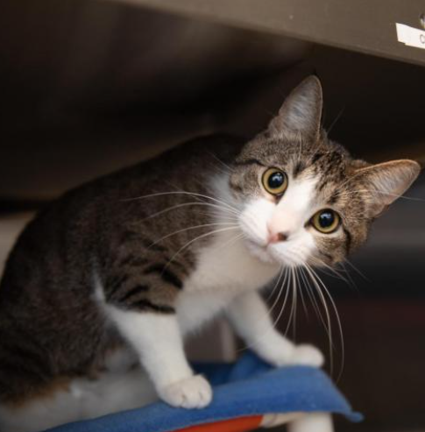
Conclusions
Age and breed are important, but sentiment and picture blurriness are statistically significant.
General suggestions: write short descriptions with either neutral or positive sentiment. Replace blurry images.
We have provide feedback to BFAF at Salt Lake City for 11 out of their 88 pets.

Slide 15
Individual Contributions
Krishna: EDA, ML Model improvement, features related to image coverage and confidence scores.
Oswaldo: ML Model improvement, sentiment analysis features, image blurriness feature, Best Friends Animal Society collaboration.
Pradeep: Implementation of App UI and Petfinder integration, app deployment, implementation of profile feedback, image blurriness feature.

